Slide 1


WDMM 3314 Web and Multimedia Engineering SDEV 2301 Principles of Software Engineering Chapter 2 Software processes Part 1 Process activities
Dr. Nour Almadhoun Alserr
Week 3
30 Sep 2023
Notes:
Overcome Challenges

Slide 2
Objectives
Understand the concepts of software processes.
Know about the fundamental process activities of software requirements engineering, software development, testing, and evolution.

Slide 3
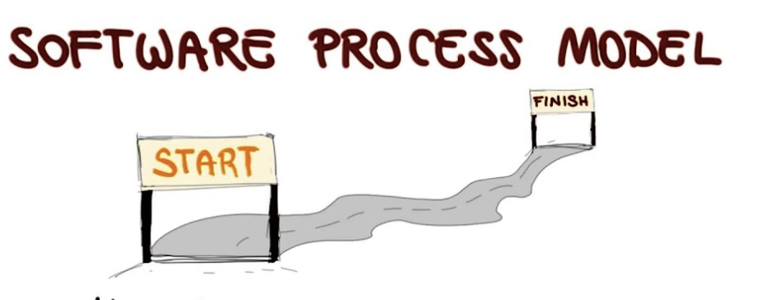

Software Process
A set of related activities that leads to the production of a software system.
4
3
2
1
https://www.majerrecruitment.com.au/6-awesome-team-building-activities/
Notes:
N Alserr

Slide 4

RECALL: FAQs
9
What are the best software engineering techniques and methods?
No universal set of software techniques that is applicable to all of different types of software system.
The software engineering methods and tools used depend on the type of application being developed, the requirements of the customer and the skills of the development team.
You can NOT say that one method is better than another.
No universally applicable software process
4

Slide 5
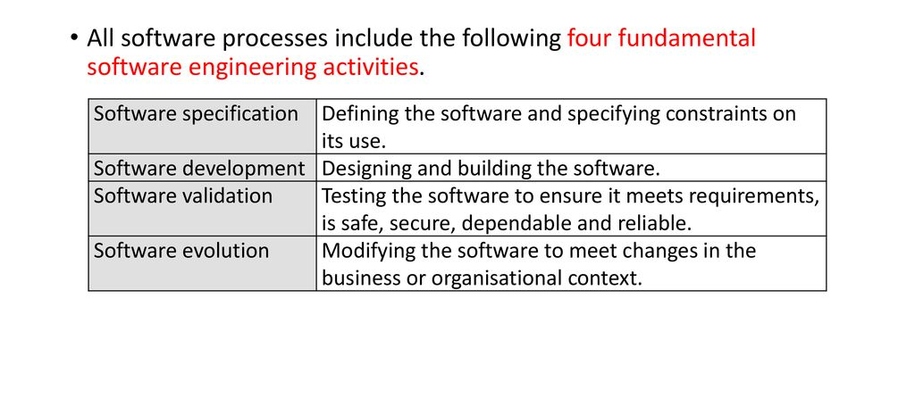
RECALL: FAQs
4
What are the fundamental software engineering activities?
efficient, usable, maintainable, dependable and secure.
5
Notes:
Software specification The functionality of the software and constraints on its
operation must be defined.
2. Software development The software to meet the specification must be produced.
3. Software validation The software must be validated to ensure that it does what
the customer wants.
4. Software evolution The software must evolve to meet changing customer needs.

Slide 6
Software Process
Describe process describe activities.
Describe process describe 1. what is produced, 2. who is involved, and 3. conditions that influence the sequence of activities.
Products: outcomes of a process activity.
Roles: the responsibilities of the people involved in the process.
Pre- and post-conditions: statements that are true before and after a process activity.
Consumer has approved all
requirements
Architectural
design
Consumer has reviewed
UML models
precondition
postcondition

Slide 7
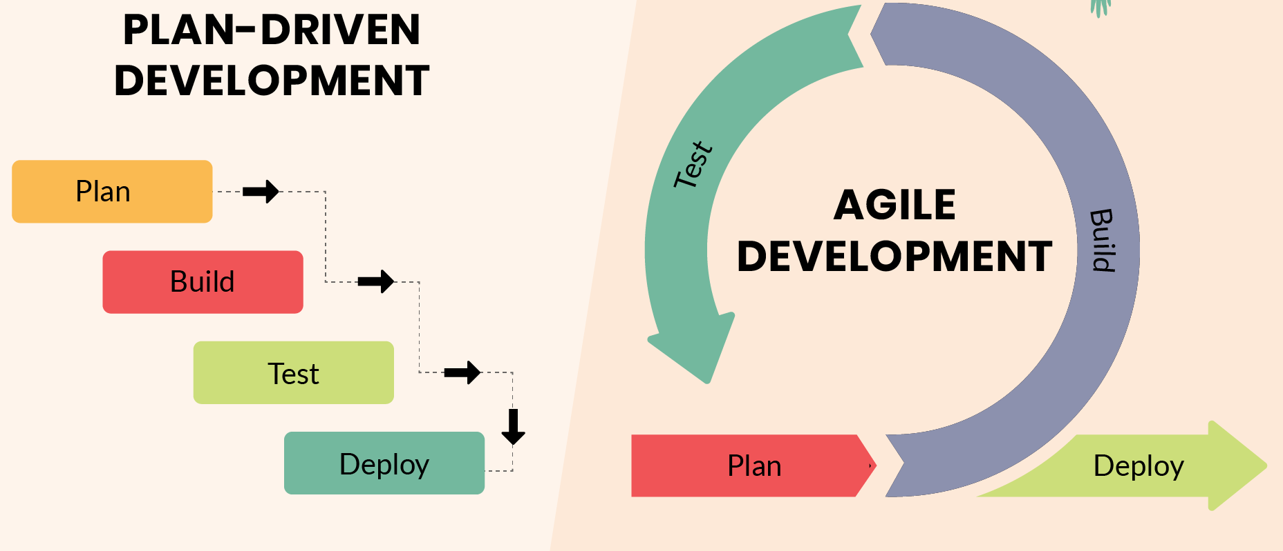
Software Process
Plan-driven processes: all process activities are planned in advance and progress is measured against this plan.
Agile processes: planning is incremental, so it is easier to change the process to reflect changing requirements.
Evolution
Evolution
In sequence
Interleaved
https://www.tryscrum.com/blogs/
Notes:
In practice (e.g., large systems), processes include elements of both plan-driven and agile approaches.
There are no right or wrong software processes.
التخطيط تدريجيincremental plannings
The four basic process activities of specification, development, validation and evolution are organized differently in different development processes.

Slide 8
(1/4) Software Specification
Software Specification or Requirements Engineering (RE):
Understanding and defining what services are required.
Identifying the constraints on the system’s operation and development.
Critical stage: mistakes lead to later problems.
Presented at two levels of detail:
End-users and customers > high-level statement (abstract).
System developers > a more detailed system specification.
Notes:
Before: a company may carry out a feasibility or marketing study to assess whether or not there is a need or a market for the software and whether or not it is technically and financially realistic to develop the software required.

Slide 9
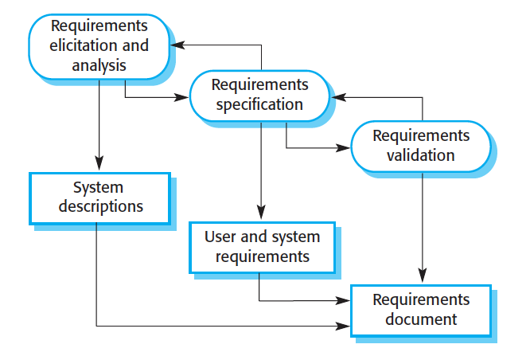
(1/4) Requirements Engineering
Notes:
استنباط

Slide 10
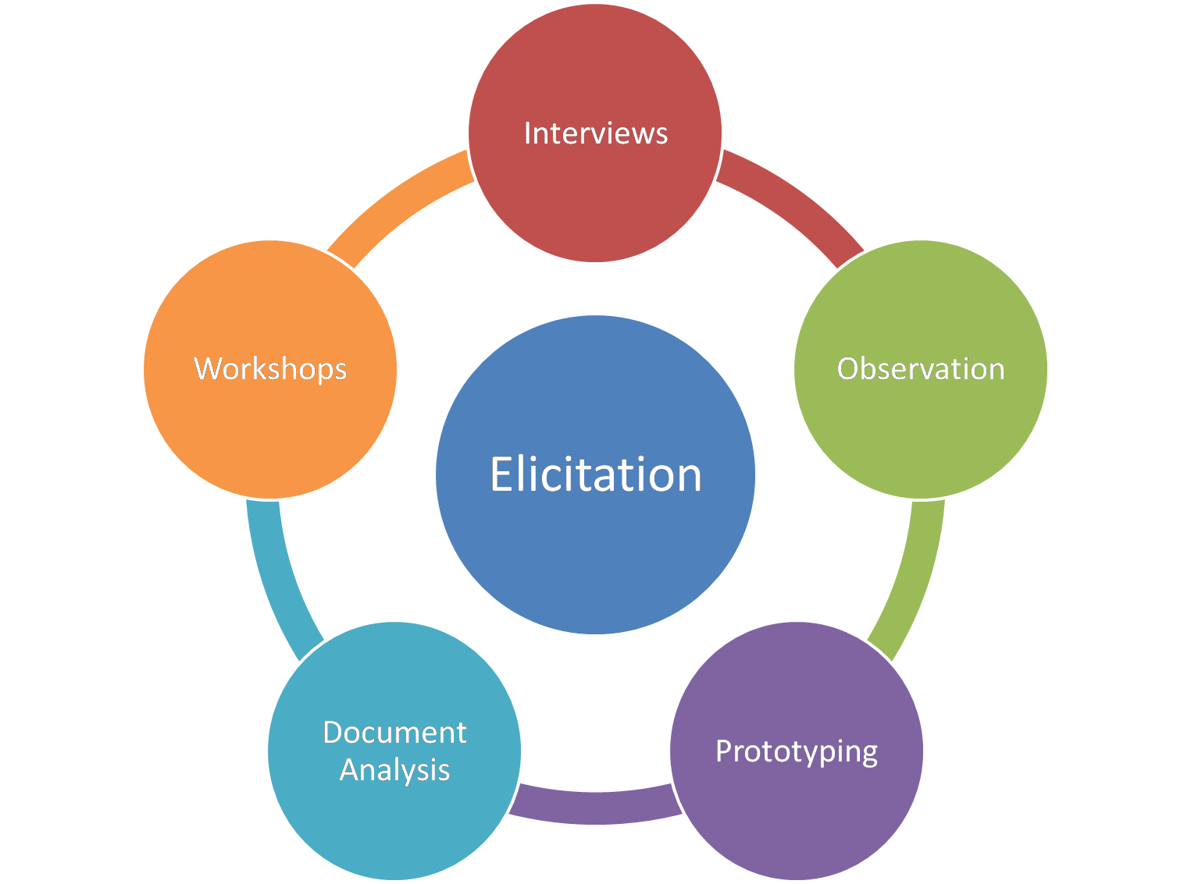
(1/4) Requirements Engineering
Requirements elicitation and analysis
Deriving the system requirements (understand the system).
Requirements specification
Translating the information gathered into a document (user and system requirements).
Requirements validation
Checking the requirements
(realism, consistency, and completeness).
https://www.modernanalyst.com/Community/CommunityBlog/tabid/182/ID/5833/Top-10-Mistakes-in-Requirements-Elicitation.aspx
Notes:
realism, consistency, and completeness. الواقعية والتماسك والاكتمال
Consistency, defined as the requirement that a series of measurements of the same project carried out by different raters using the same method should produce similar results,

Slide 11
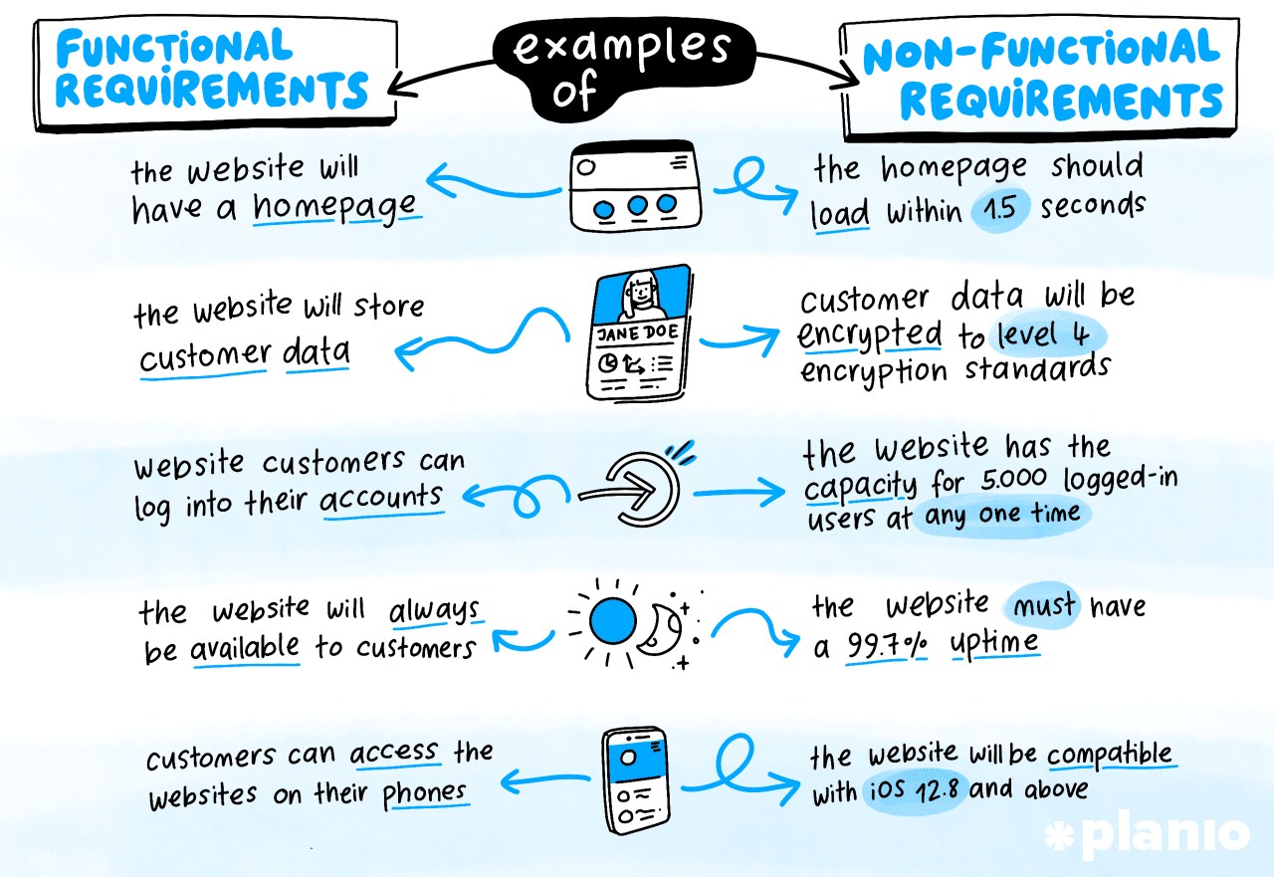
(1/4) Requirements Engineering
https://plan.io/blog/non-functional-requirements-nfrs/
Notes:
Functional requirements
Statements of services the system should provide, how the system should react to particular inputs and how the system should behave in particular situations.
May state what the system should not do.
Non-functional requirements
Constraints on the services or functions offered by the system such as timing constraints, constraints on the development process, standards, etc.
Often apply to the system as a whole rather than individual features or services.

Slide 12
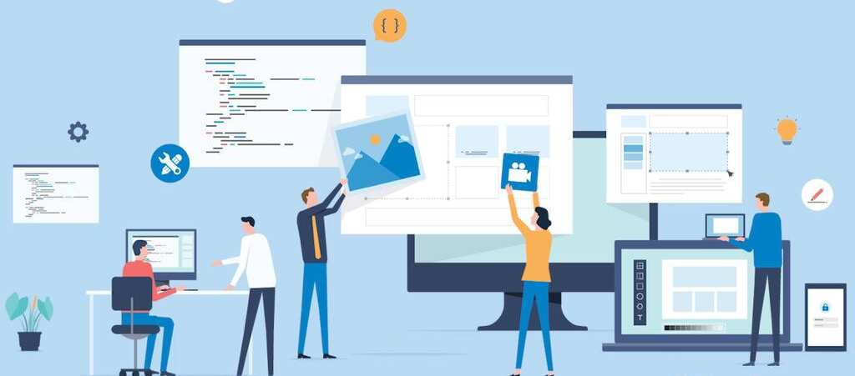
(2/4) SW Design and Implementation
The process of converting the system specification into an executable system.
Software design Description of:
Software structure.
Data models and structures.
Interfaces between system components.
Algorithms used (sometimes).
https://study.com/learn/lesson/software-engineering-definition-processes.html
Notes:
A software system's structure is a division of that system into a set of parts and the relations between those parts.

Slide 13
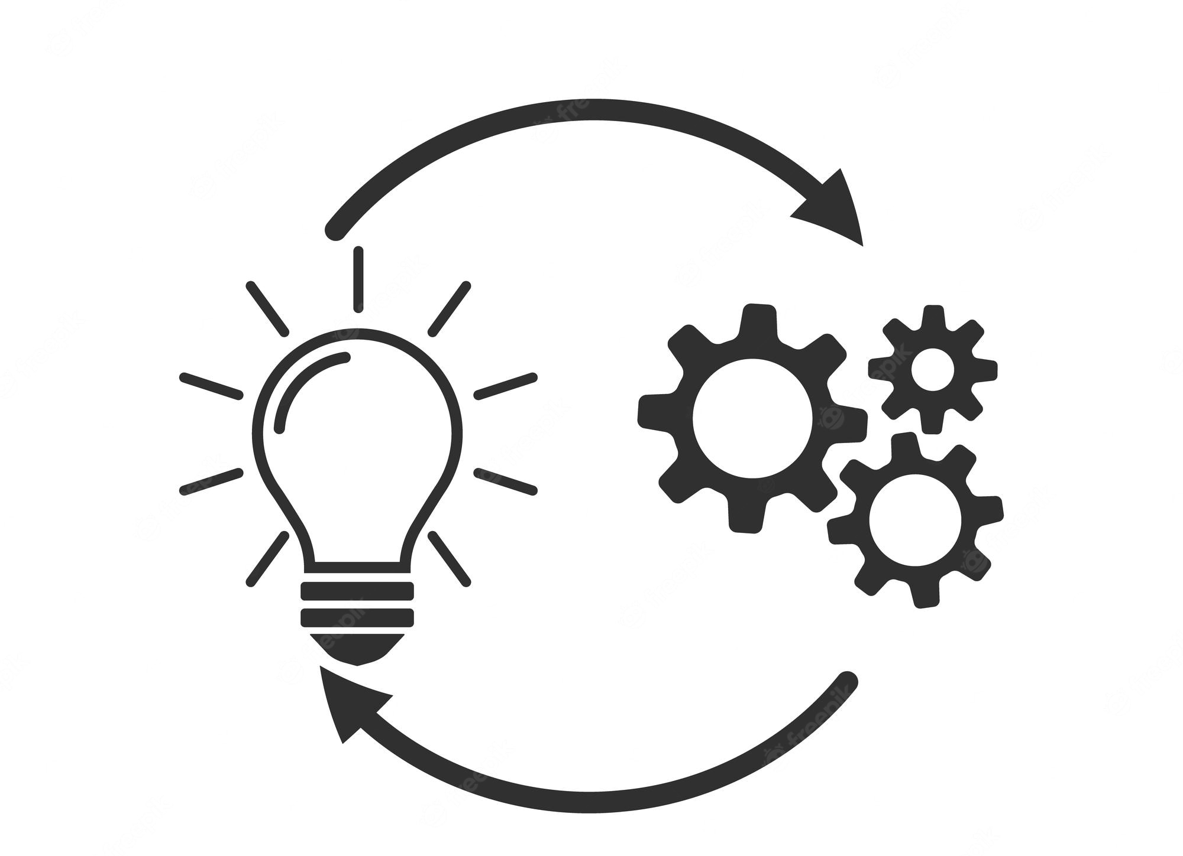
(2/4) SW Design and Implementation
Implementation
Translate these structures into an executable program.
The activities of design and implementation are closely related and may be interleaved.
https://study.com/learn/lesson/software-engineering-definition-processes.html

Slide 14
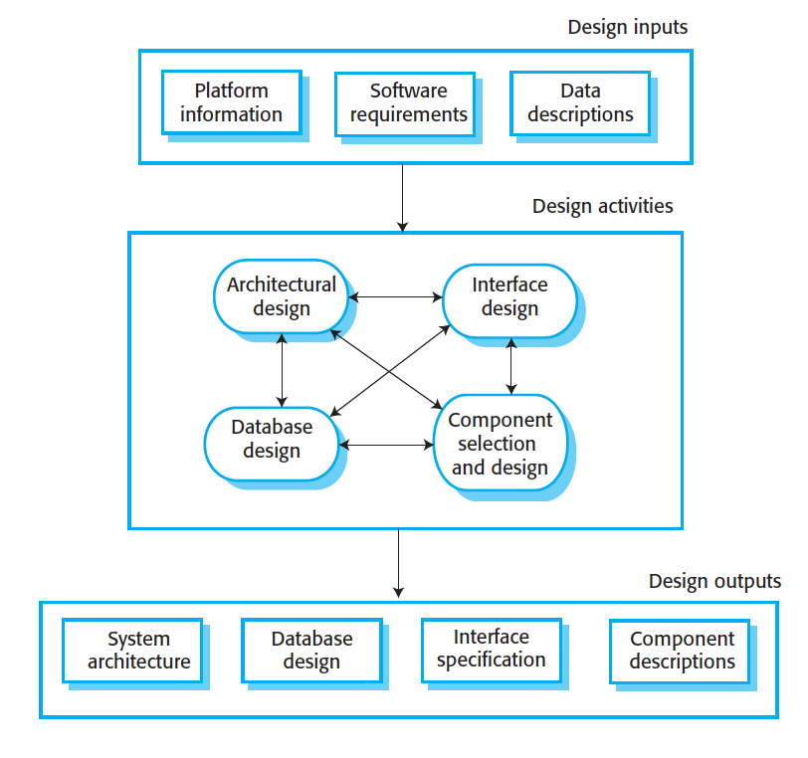
(2/4) SW Design and Implementation
operating system
database
middleware
A General Model of The Design Process
(Information systems)
Notes:
The design process activities are both interleaved and interdependent.
New information about the design is constantly being generated, and this affects previous design decisions. Design rework is therefore inevitable.
Middleware is software that lies between an operating system and the applications running on it
The activities in the design process vary, depending on the type of system being developed. For example, real-time systems require an additional stage of timing design
but may not include a database, so there is no database design involved.
An information system (IS) is an interconnected set of components used to collect, store, process and transmit data and digital information

Slide 15

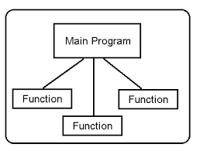
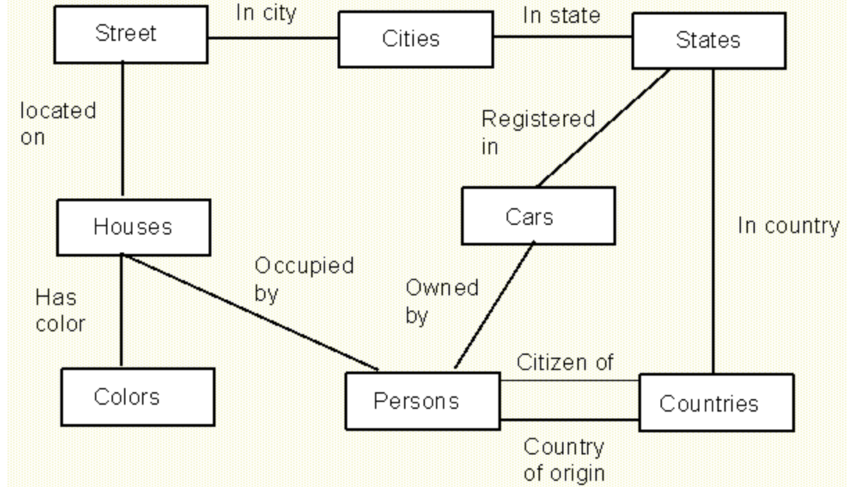
(2/4) Design Activities
Architectural design: identify the overall structure of the system, the principal components (subsystems or modules), their relationships and how they are distributed.
Database design, where you design the system data structures and how these are to be represented in a database.

Slide 16
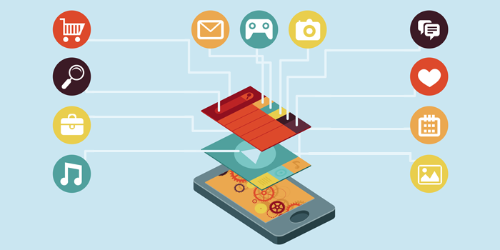
(2/4) Design Activities
Interface design: define the interfaces between system components.
https://www.foroes.net/tips-for-creating-the-best-user-interface-design-for-your-app/

Slide 17
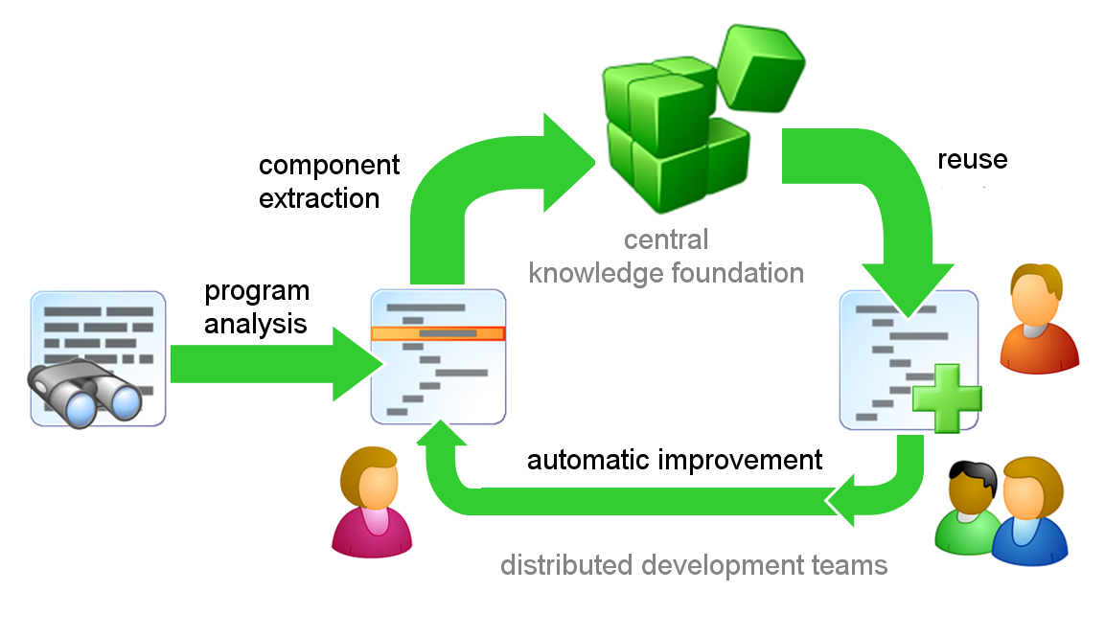
(2/4) Design Activities
Component selection and design: search for reusable components. If not available, you design new software components (simple component description ).
https://www.loginworks.com/blogs/reuse-code-object-oriented-programming/

Slide 18
(2/4) Design Activities
For critical systems, the outputs of the design process are detailed design documents (accurate descriptions).
If a model-driven approach is used, the design outputs are design diagrams.
In agile methods of development are used, the outputs of the design process may not be separate specification documents but may be represented in the code of the program.

Slide 19
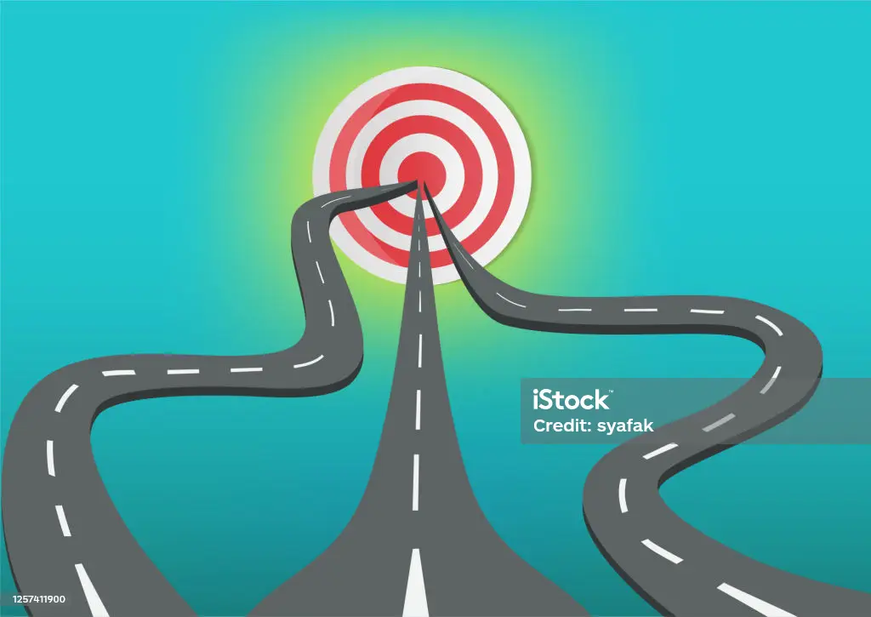

(2/4) Implementation
Programming is an individual activity (no general process).
Start with understandable components
Define data or leave data unspecified
Leaving familiar components till last
كل الطرق تؤدي الى روما
https://www.istockphoto.com/vector/many-way-to-reach-a-target-or-goal-gm1257411900-368493609

Slide 20
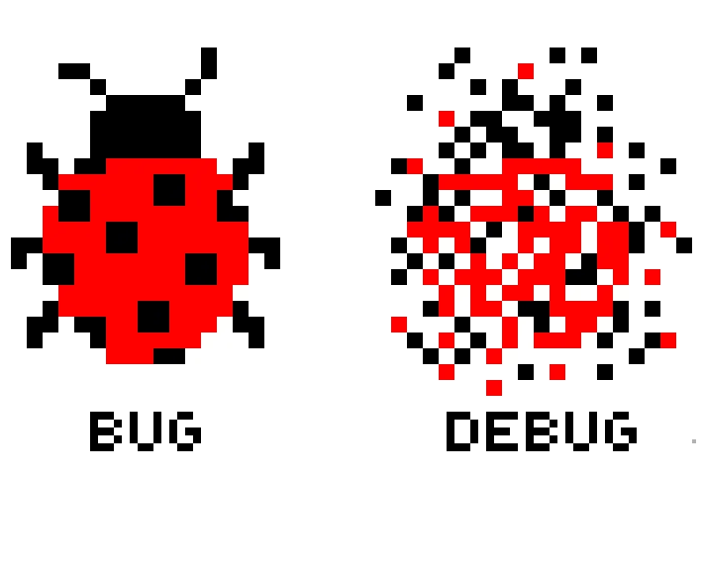
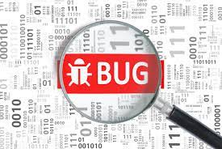
Code Testing
An error in a program is called a bug.
Eliminating errors is called debugging (generate hypotheses about the observable behavior of the program “code tracing”).
Defect Testing
Debugging
https://www.beningo.com/embedded-basics-classifying-software-bugs/
https://medium.com/@imAkash25/bug-debug-3445497d4daf

Slide 21
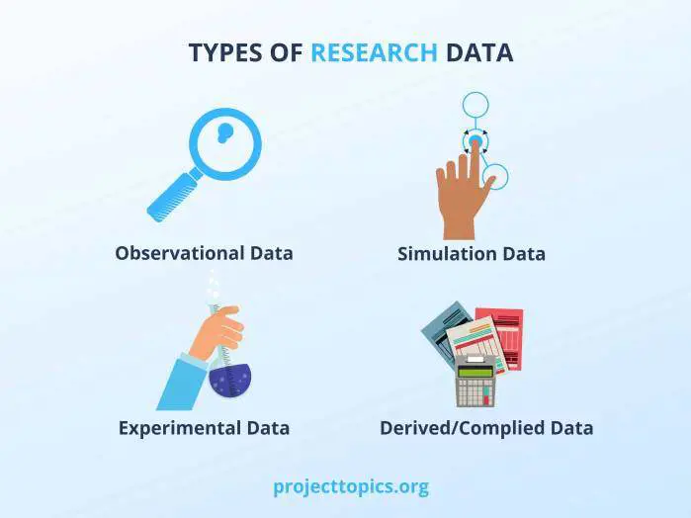
(3/4) Software Validation
Verification and Validation (V & V) is intended to show that a system conforms to its specification and meets the requirements of the system customer.
Involves:
Program testing: the system is executed using simulated test data )principal validation technique, most time and efforts(.
Checking processes, such as inspections and reviews.
https://www.optimizely.com/insights/blog/what-is-derived-data-and-how-can-you-use-it-for-your-business/
Notes:
data simulation: The process of creating synthetic or fake data that resembles real-world data.

Slide 22
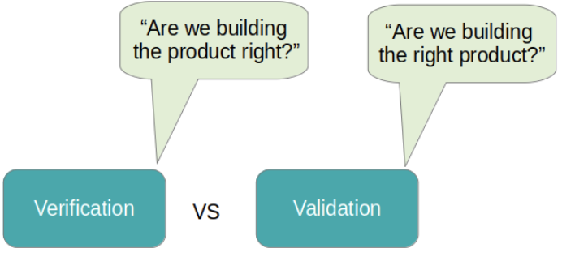
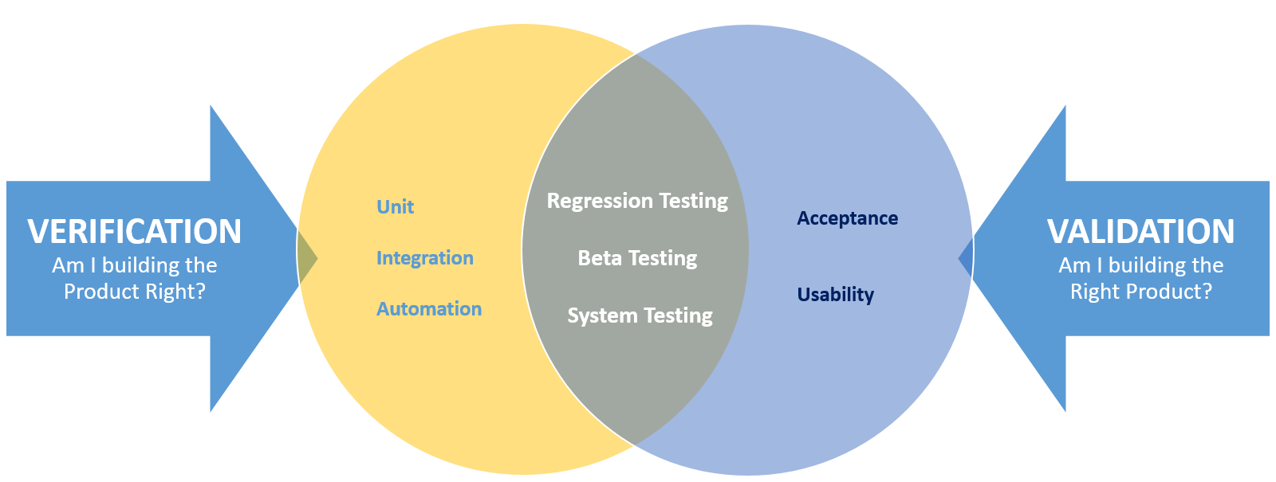
(3/4) Software V & V
https://programmerbay.com/difference-between-verification-and-validation-testing/
https://www.pcloudy.com/blogs/verification-and-validation-in-testing/
Notes:
data simulation: The process of creating synthetic or fake data that resembles real-world data.

Slide 23
(3/4) Testing
Component (Unit) testing
Individual components are tested independently.
Components: functions, objects or coherent groupings of these entities.
System testing (system: integrated components)
If System meets its functional and non-functional requirements.
Testing of emergent properties.
Large systems: multistage process (subsystems).

Slide 24
(3/4) Testing
Customer (Acceptance) testing
The system is tested by the system customer “real customer data” (or “beta testing” for selected potential customer) rather than with simulated test data.
Customer testing shows how well the software product meets the customer’s needs.
Notes:
Beta testing involves delivering a system to a number of potential customers who agree to use that system. They report problems to the system
developers. This exposes the product to real use and detects errors that may not
have been anticipated by the product developers. After this feedback, the software
product may be modified and released for further beta testing or general sale.

Slide 25
(3/4) Testing
Incremental and agile process (test-driven): tests are developed along with the requirements before development starts (no delays).
Plan-driven software process (test plans) : V-model

Slide 26
(3/4) Testing
Testing phases in a plan-driven
software process

Slide 27
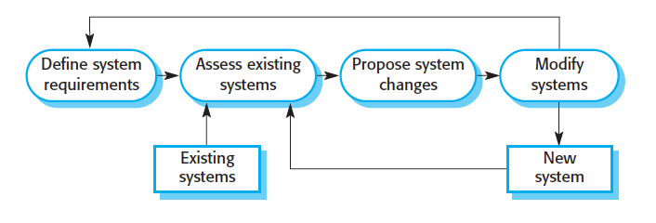
(4/4) Software Evolution
Software must be flexible and can change (evolve).
Development and Evolution “maintenance” (a continuum, very few software systems are completely new systems).
Software system evolution

Slide 28
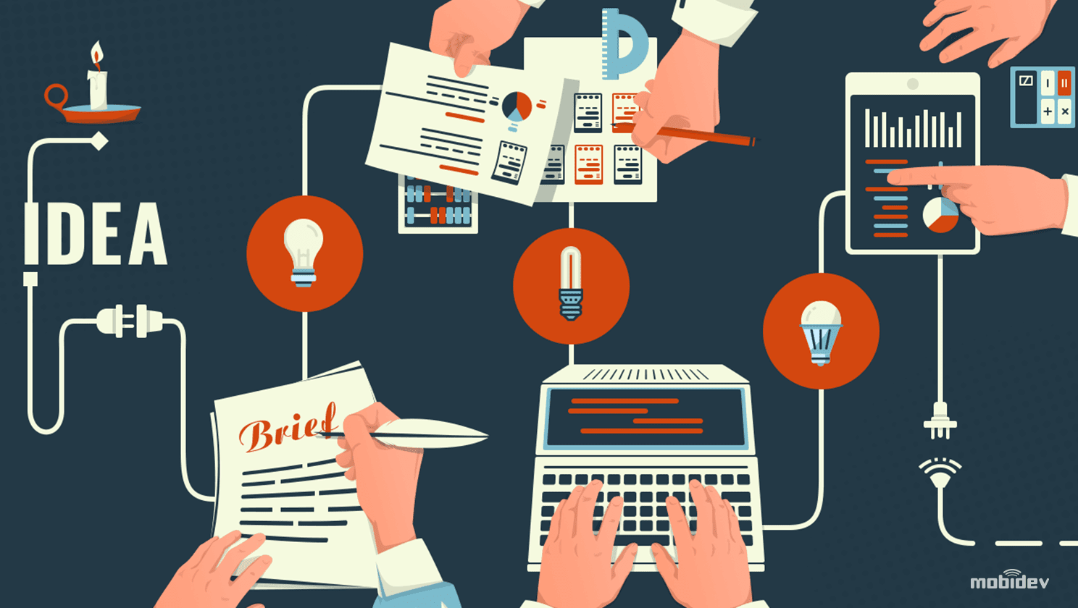
(4/4) Software Evolution
It is more realistic to think of software engineering as where software is continually changed over its lifetime in response to:
1
changing requirements
2
customer needs
https://mobidev.biz/blog/managing_evolution_of_a_software_product

